Slide 1
Smart Lock: Group 6
Presentation
Notes:
Noor

Slide 2
The Team
Ali Al-Hajri
Electrical Engineering
Idoko Abuh
Electrical Engineering
Mark Rodriguez
Electrical Engineering
Noor Pirzada
Computer Engineering
Notes:
Noor

Slide 3
What is Smart Lock?
can be installed on mechanical locks
upgrade your ordinary lock
Main parts ( lock and key )
virtual key
sensors: RFID, Fingerprint, Touchscreen, Bluetooth, and Facial Recognition.
Key
Virtual key that can grant access to third parties by the mean of virtual key.
Notes:
Ali
A smart lock is an electromechanical lock which is desgined to perform locking and unlocking operations on a door when it receives such instructions from various sensors. it can be installed on a mechanical locks ( the typical one most of you have at home ) and could be physically upgrade the ordinary lock.
Smart locks, like the traditional locks, need two main parts to work: the lock and key. for us the lock is a chosen one by us, and the key is our sensors which we are going to talk about in the next slides. key doesnt have to be physical like the one we have. it can be configured by the user. Also, smart locks allow users to grant access to third parties by the mean of virtual key. this key can be sent through the recipient smartphone over the standard messaging protocol such as email or SMS. once the key is sent the recipient will be able to unlock the door.
Smartlocks may use bluetooth low energy and CCM to communicate.

Slide 4
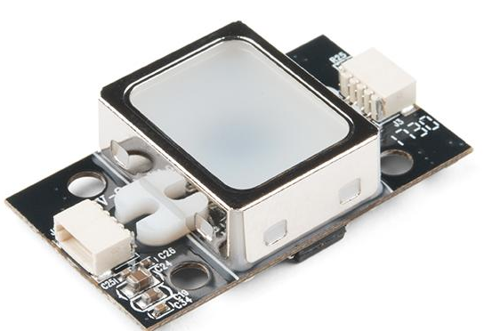
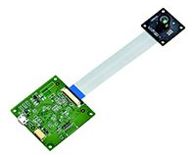
RFID
Touchscreen
KeyPad
How it works
Approach the door
Choose any sensor to use. this will activate the MCU and user will use that sensor to unlock the door.
The MCU will process the data from the source and determine whether to grant access or deny.
Fingerprint Scanner
Camera
Notes:
Ali

Slide 5
Motivation
Losing keys
Easy access
Saving money
Giving access to others
easy monitoring
Learning different technologies
Notes:
Ali

Slide 6
Goals And Objectives
Using as many features to have an all in one smart lock.
Build a smart lock that compete with other smart locks in the market.
Implement a system to use low energy consumption with various sensors such as Fingerprint, TFT Touch Screen, RFID, Bluetooth, and a Facial Recognition Camera [stretch goal ].
Ease of installation to various buildings and homes.
Easy use by any member of the household, age does not matter.
Notes:
Ali

Slide 7
Project Specifications
12V power supply unit ( Wall Plug )
Backup 9v battery that powers the system in case of power loss.
RFID Card
Fingerprint Scanner
App
Touchscreen with embedded keypad
Bluetooth
Facial Recognition [ Stretch Goal ]
Notes:
Ali

Slide 8
Design Constraints
Low Price
Durability
Battery life
Ease of Use
Notes:
Mark
low price - beat competitor pricing when comparing features, quality of product, and price.
durability - waterproof, high quality electrical components.
battery life - will not have an issue with power loss

Slide 9
Relevant Standards
ANSI/IEC 60529-2004 - Electrical Equipment Enclosure Standards
IP Codes
Protection of equipment
Protection of personnel
Protection against water
IP - 44
IPC - Institute of Printed Circuits
PCB Standards
Class 1: Computer equipment
Class 2: Communication equipment
Class 3:High reliability equipment
IPC 2221
IEC - International Electrotechnical Commission
Power Supply Standards
IEC 62368-1 - Power Supply
Not to exceed 600 V
Ethical Standards
Environmental Standards
Notes:
Mark
degrees of protection for enclosures of electrical devices
From 0 - 6 where 0 is no protection and 6 is highest degree of protection such as dust tight.

Slide 10
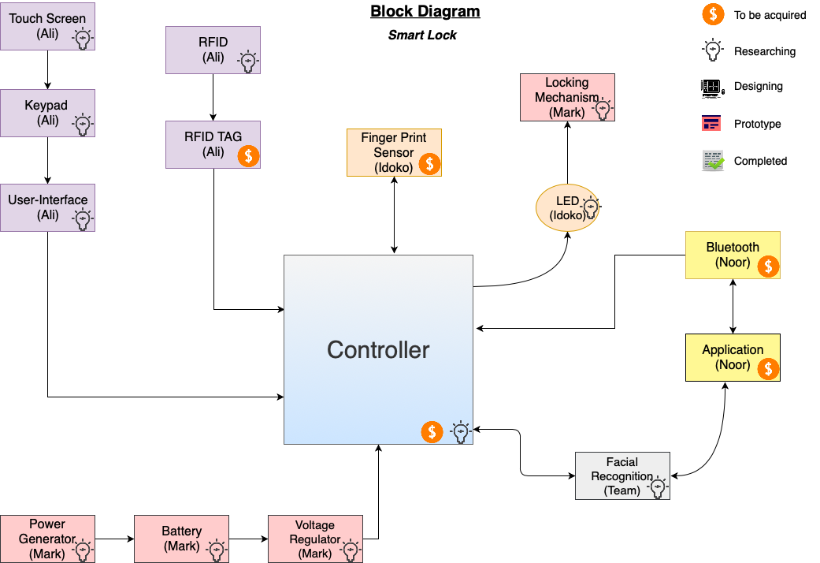
Block Diagram: Hardware and Software
(Idoko)
Notes:
Noor

Slide 11
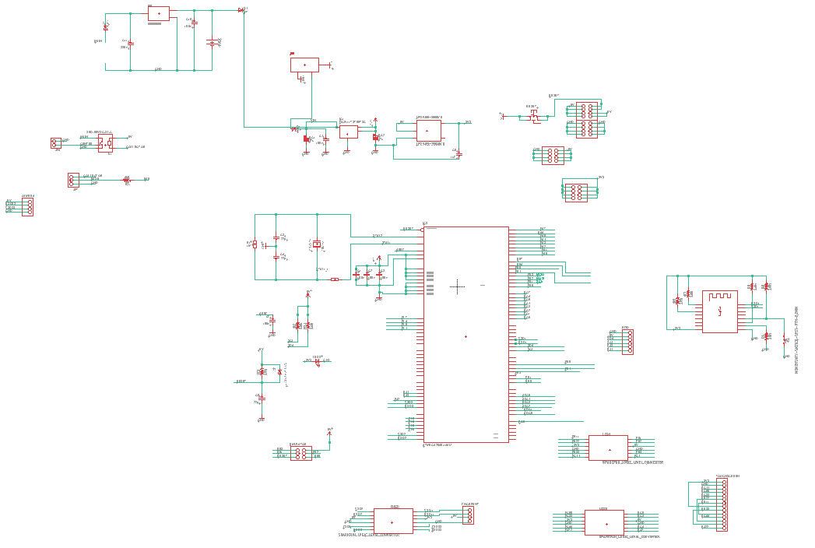
Project Schematic
Notes:
Ali

Slide 12
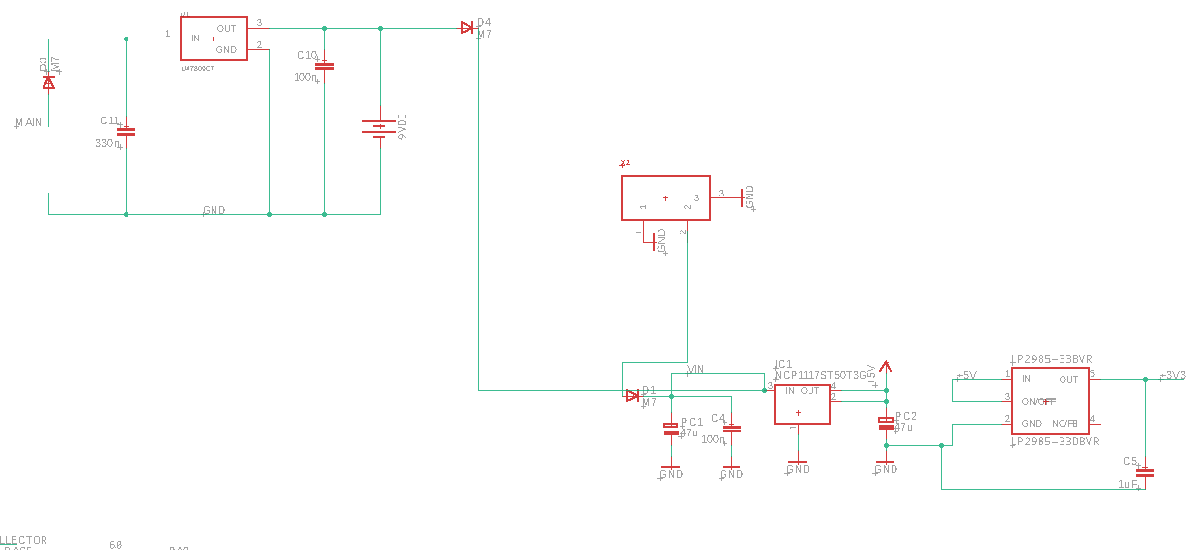
Power Circuit
Key Features:
2 Stage Power Circuit
12V input power source
Backup 9V battery source
Barrel Jack Regulator 12 V - 5 V
Low-Dropout voltage regulator from 5 V - 3.3 V
Notes:
Mark
2 stage power circuit -
1st -
Input power connected to Voltage Reg
9 V battery source connected in parallel as backup power source
2nd -
barrel jack - to regulate 12 volts through IC1 and output 5v.
Then power goes through second regulator to output 3.3V. In this way we have two regulated voltages to be used by rest of components, 5v and 3.3v
NCP - Low-Dropout Positive Fixed and Adjustable Voltage Regulator
LP2985 - A LOW-NOISE LOW-DROPOUT REGULATOR WITH SHUTDOWN
we have various components that require 5 volts and 3 volts to operate.

Slide 13
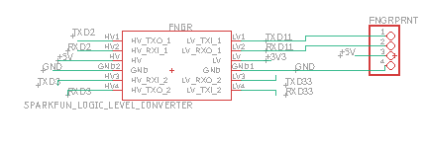
FingerPrint
Notes:
Ali

Slide 14
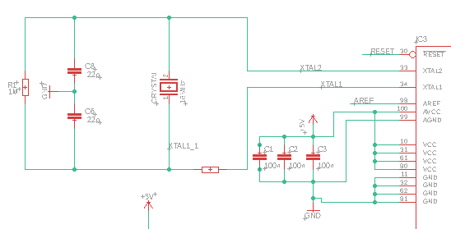
Decoupling cxt
Notes:
Ali

Slide 15
Significant Components and parts
01
Notes:
Mark - LCD, magnetic lock, power
Idoko - microcontroller
Noor - Bluetooth adapter
new rfid had issues with last

Slide 16
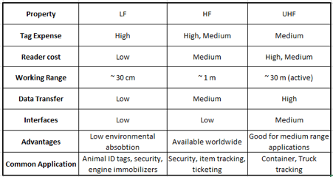
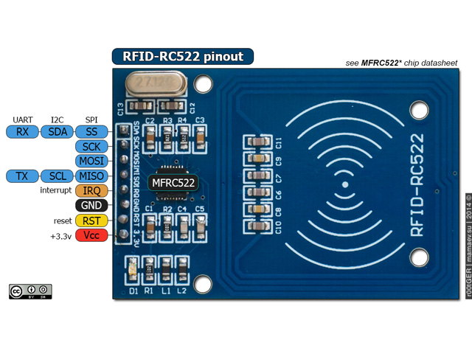
RFID
Passive and Active RFID
HF, LF, and UHF
Product Support
RC 522 RFID
3.3V
Notes:
Mark
Passive: no external power source, good for short range applications, less expensive
active: require power source, good for long range applications
RC 522 RFID - in expensive, HF, cheaper tags

Slide 17
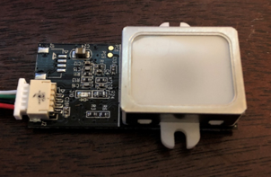
Fingerprint Sensor
Sensor Comparison
 | FPMA10A | GT511C1R
Price | $20.99 | $18.00
Operating Voltage/Current | 3.6 - 6 V / 120 mA | 3.3 - 6 V / 130 mA
Scan Time | 1 Second | 1.5 Seconds
Storage Capacity | 160 prints | 20 prints
Communication Protocol | UART | UART
Notes:
Mark
GT511C3 IF NEED MORE PRINTS GREAT ADD ON
SUPPORT BETTER FOR GT5 version
looked better

Slide 18
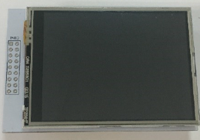
Display
 | OLED | LCD
Brightness | Good | Better
Black Level | Better | Good
Contrast | Better | Good
Resolution | Tie | Tie
Availability | Low | High
Price | ~$100 | $8.00
Notes:
Mark
OLED - illuminated by light emitting diodes, costlier, hard to find
LCD - illuminated by backlight, cheaper, easy to find

Slide 19
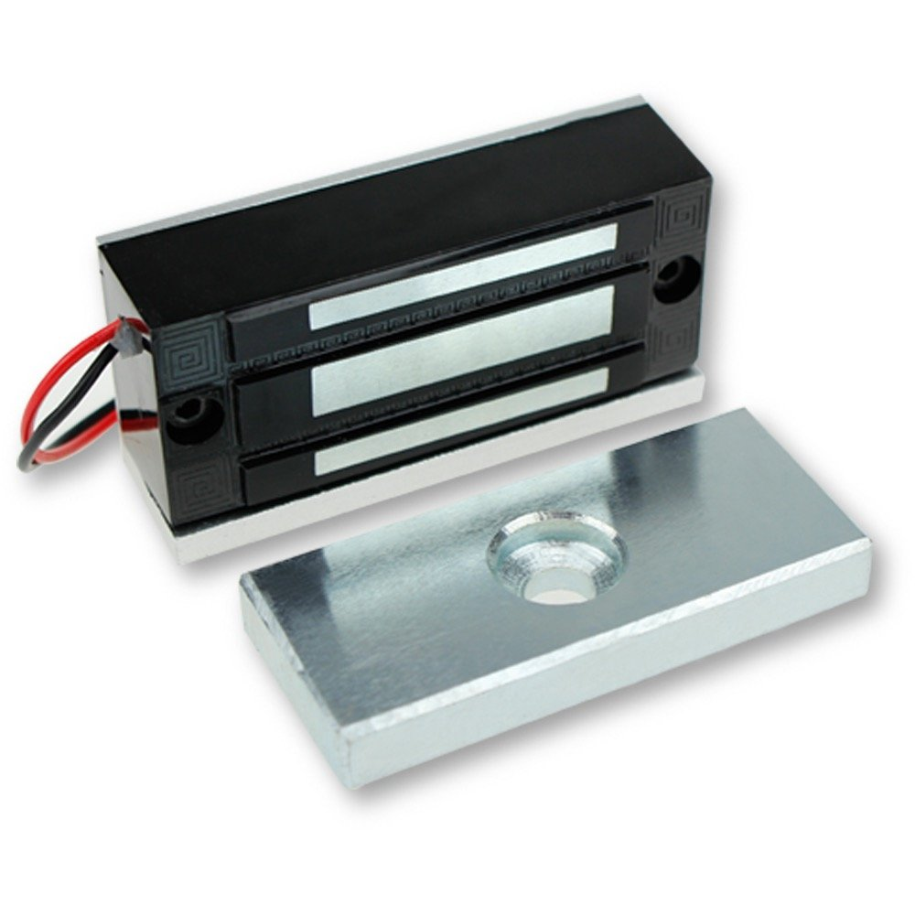
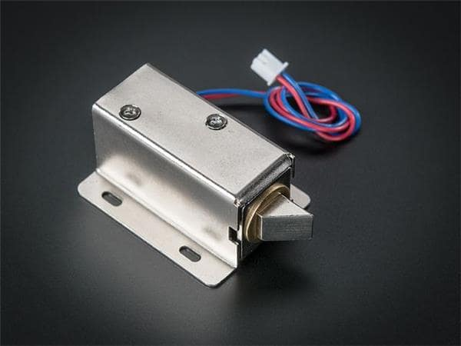
Magnetic Lock
 | Solenoid Latch | Magnetic Lock
Price | $5 | $16
Operating Voltage | 12 V | 12 V
Operating Current | 400 mA | 380 - 500 mA
Durability | Rust-proof | Water-proof
Notes:
Mark
Solenoid latch because it is easier to install and cheaper. Less power consumption.

Slide 20
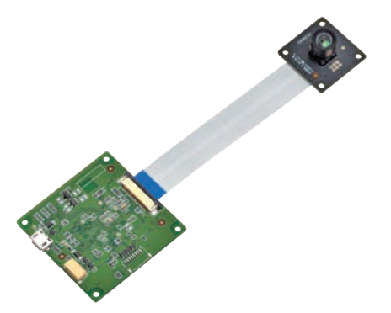
Facial Recognition
Facial recognition and image processing is done via the Human Vision Components (HVC-P2) system which consist of a camera and FPGA processor
Can estimate gender, age, gaze, facial expression, blink rate and facial recognition.
Communicates to the MCU via UART
Notes:
Idoku

Slide 21
Microcontroller Selection
Notes:
Idoko

Slide 22
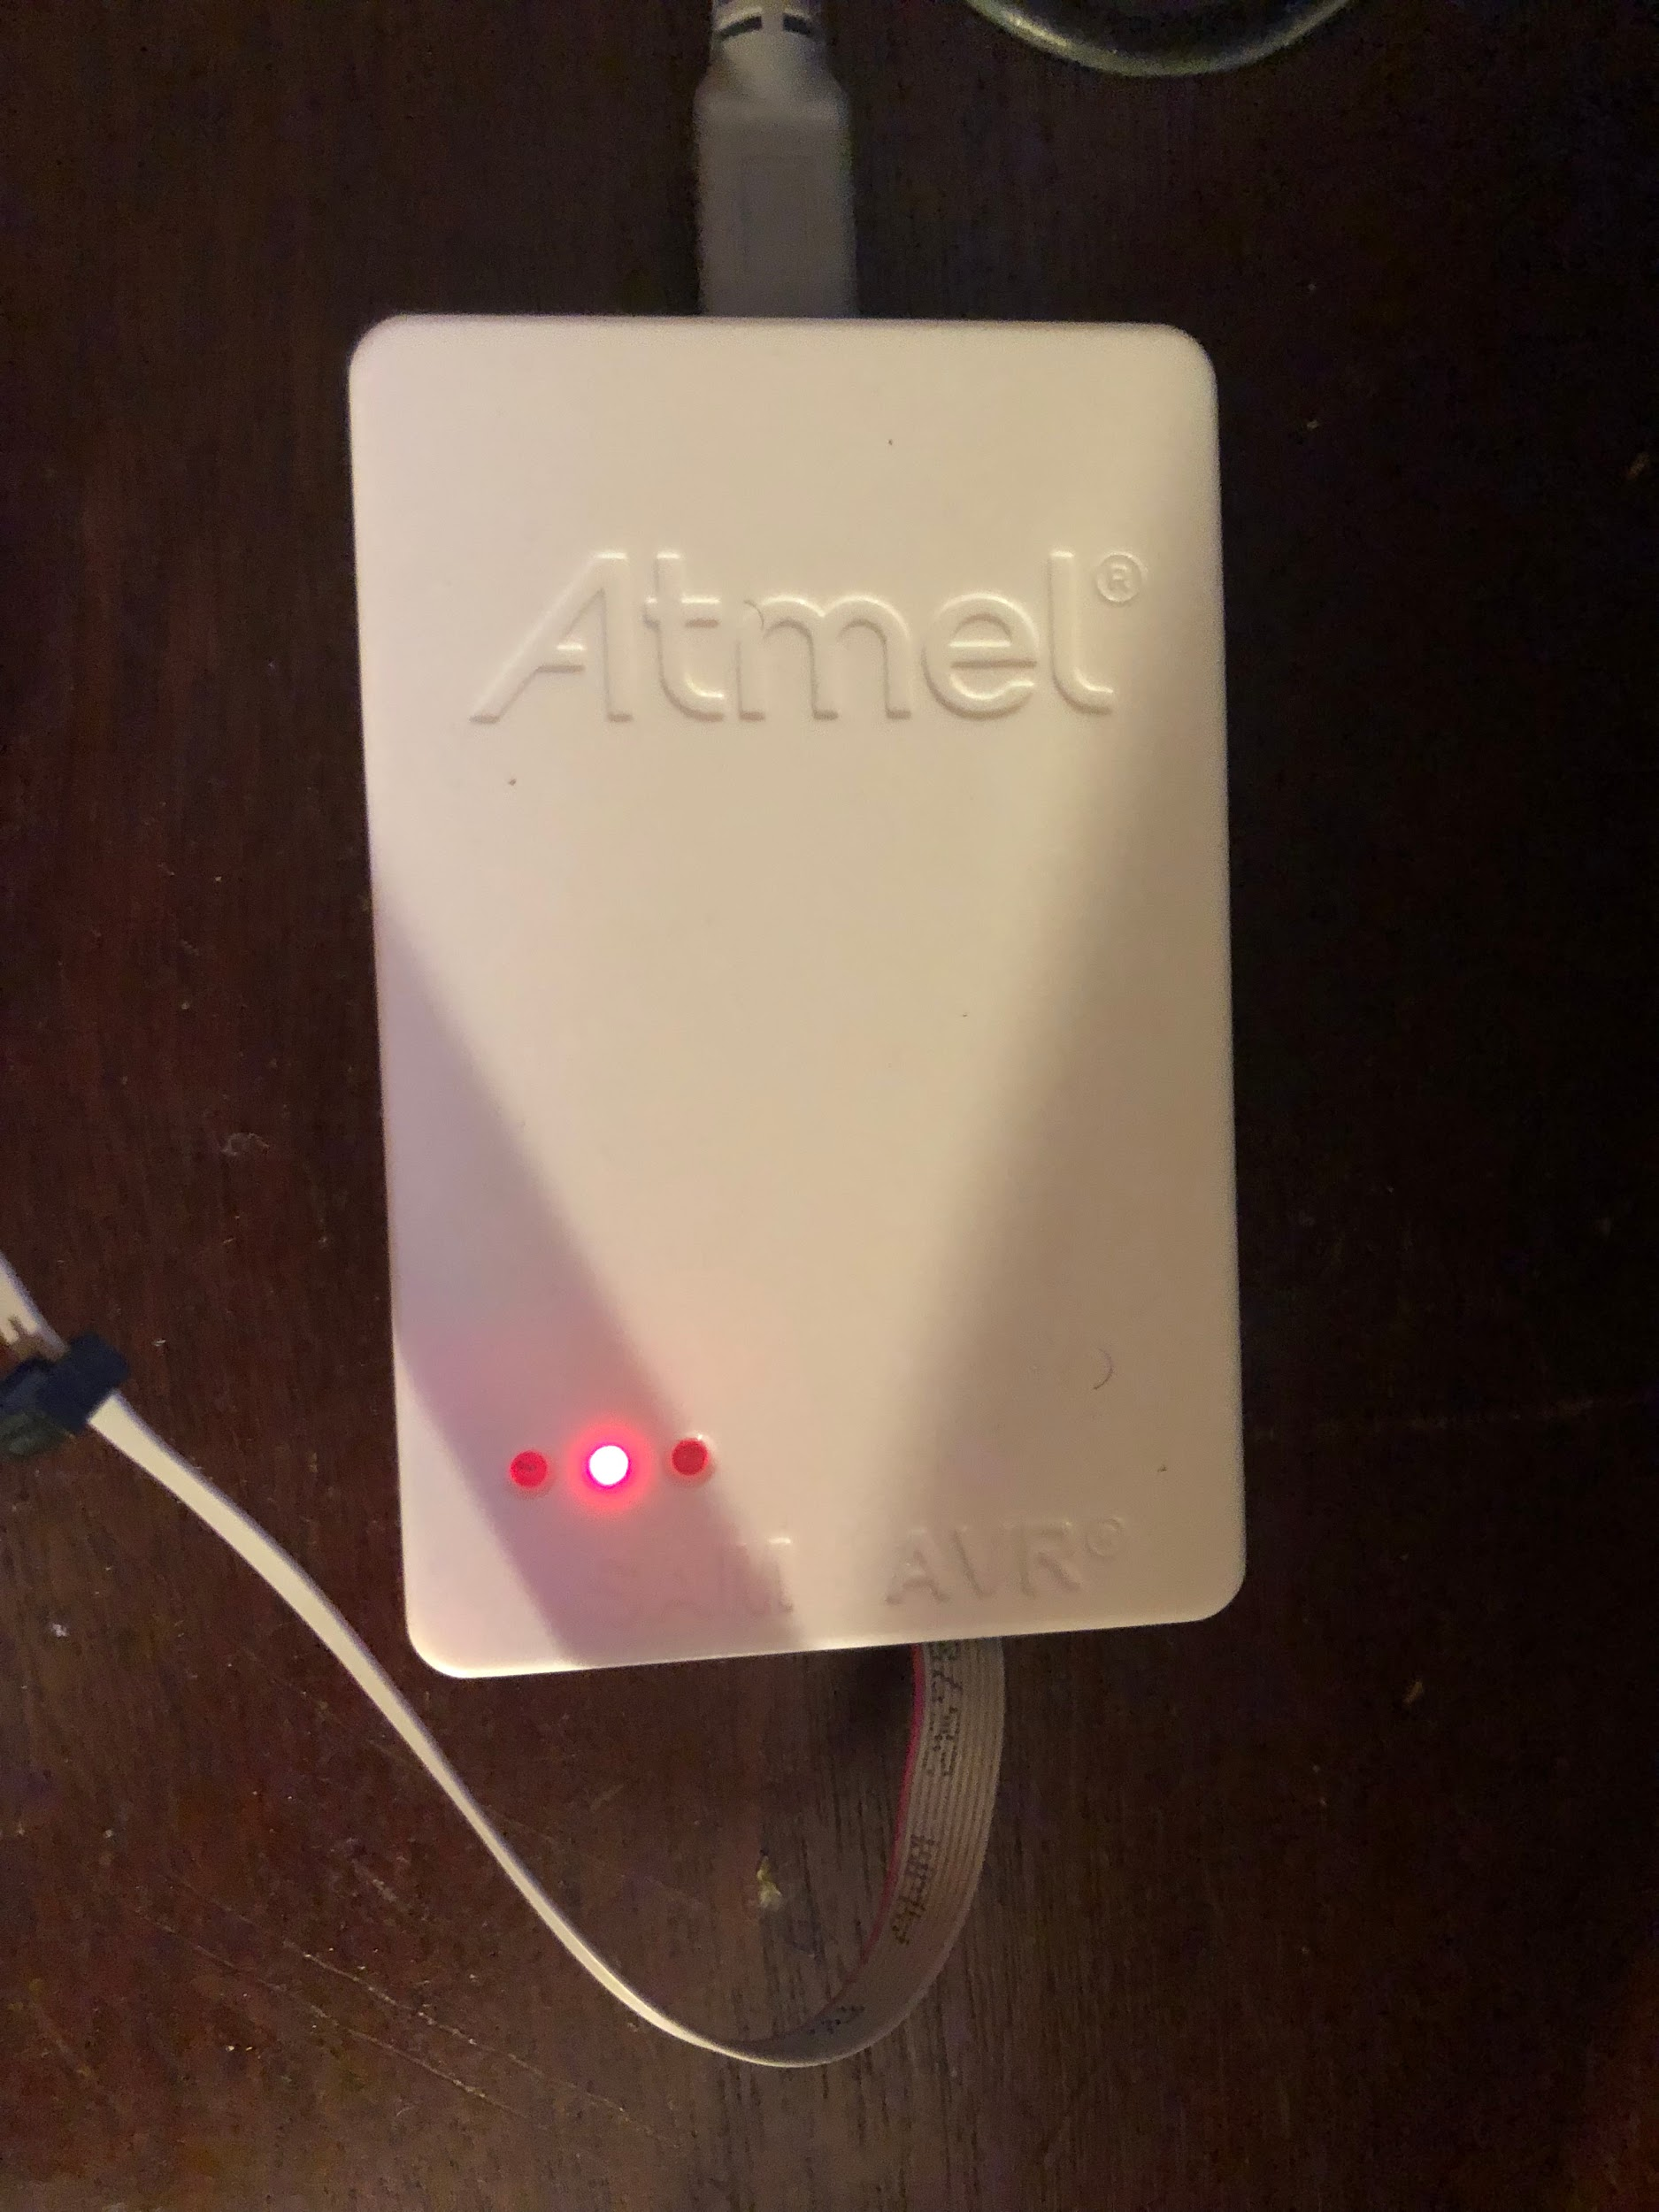
Hardware Debugger
The smartlock code is written in Atmel Studio in C language because it gives us an intimate understanding of our embedded system.
The code is then uploaded to the MCU via a hardware debugger
This allows for debugging which gives insight into the state of each register, providing an effective path to solving issues during the coding process
Notes:
Idoku

Slide 23
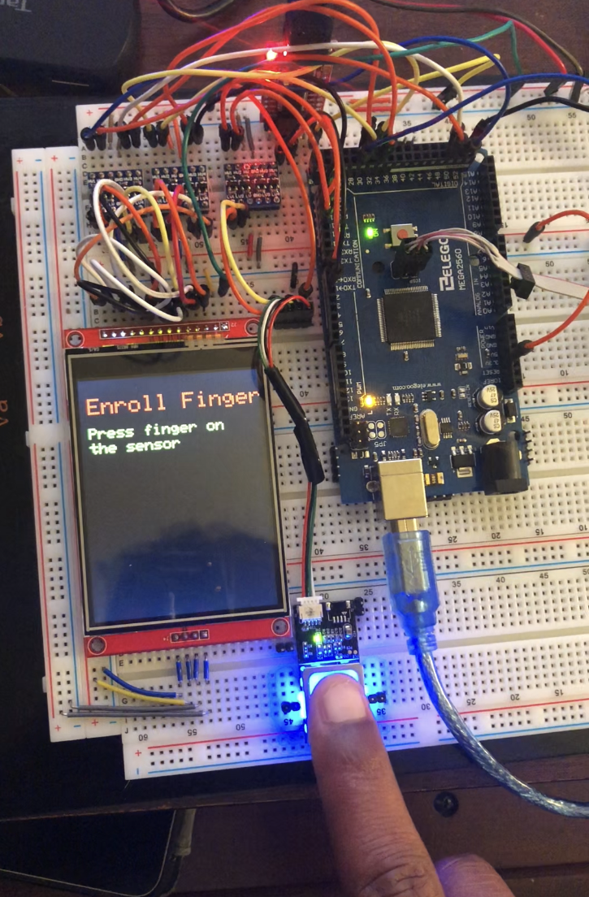
Breadboard Testing
Each module is first placed on the PCB and after applying power and ground, each pin is tested to verify that it has the correct voltage
While consulting the manual, each module is coded in C for the desired functionality
Notes:
Idoko

Slide 24
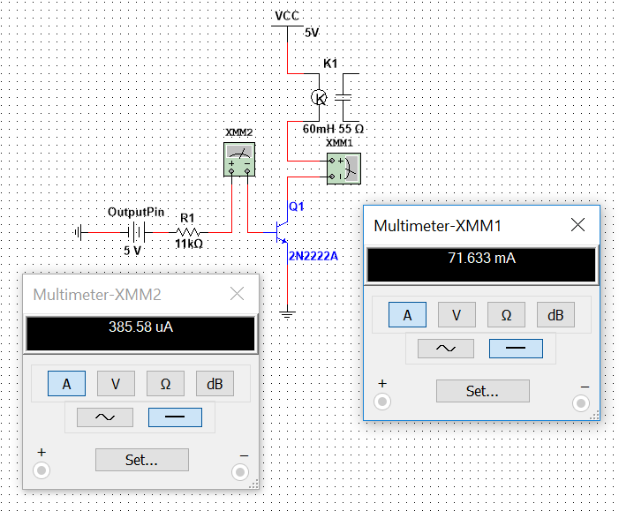
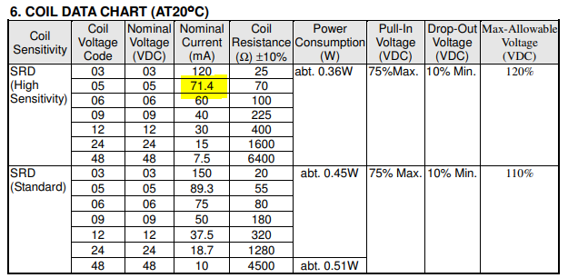
Relay
MCU pins output < 40mA
Nominal current for the relay to reliably trigger is 71.4mA
To supply the relay with the nominal current, while also staying within the current limits of the MCU’s output pin, a Bipolar Junction Transistor circuit is implemented
Notes:
Idoko

Slide 25
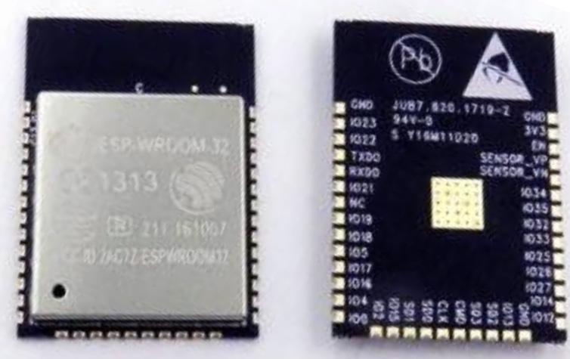
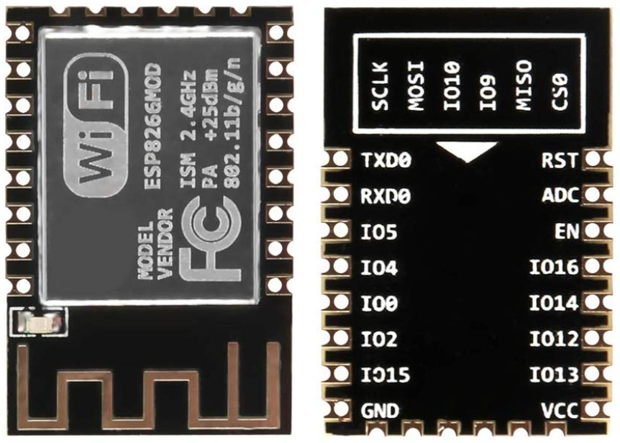
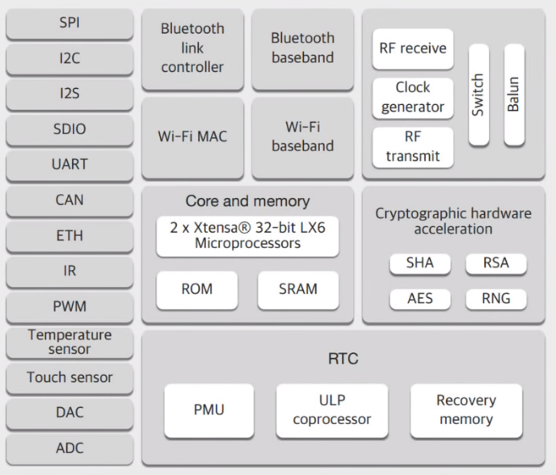
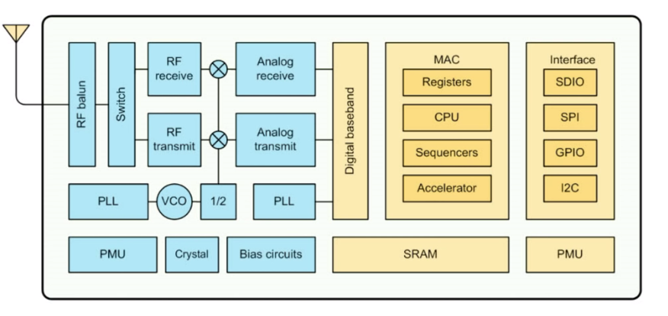
Wireless vs Bluetooth
ESP 32
ESP 8266
Notes:
Noor
-We chose bluetooth because it doesnt need a seperate network
-really long battery life
-ideal for short ranges

Slide 26
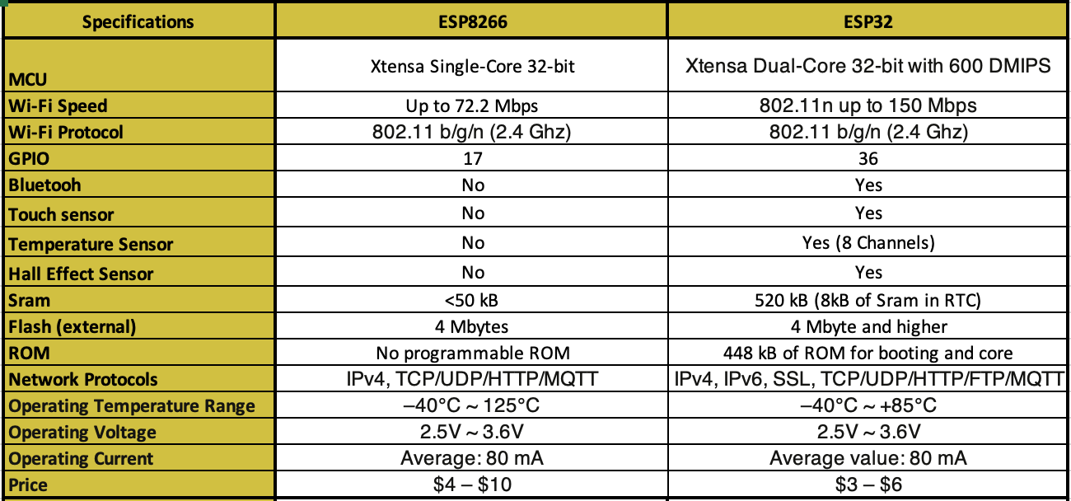
Specification Comparison
Notes:
Noor Noor
Fix network protocals...swap them

Slide 27
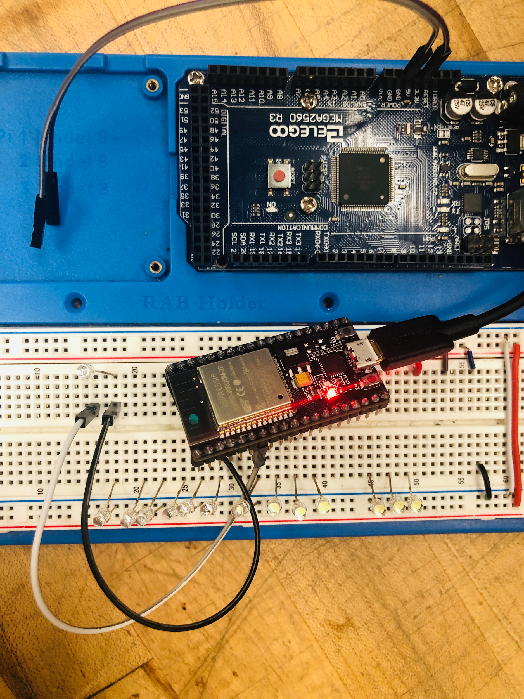
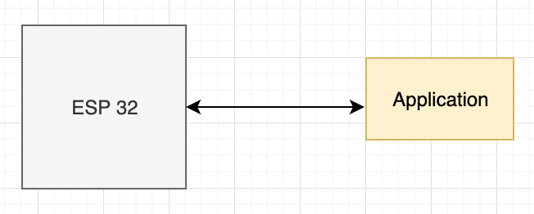
Bluetooth Testing
Notes:
Noor

Slide 28
Application
02
Notes:
Noor

Slide 29
Smart Lock Mobile
Notes:
Noor

Slide 30
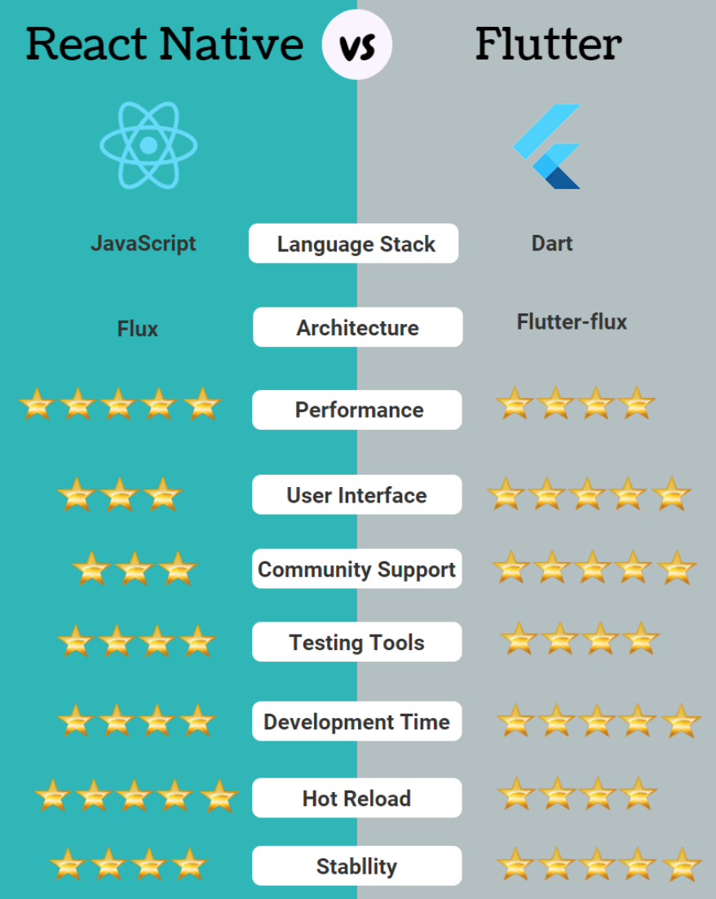
Framework for
Application
Notes:
Noor

Slide 31
Project Administration
03
Notes:
Mark Starts -
Noor

Slide 32
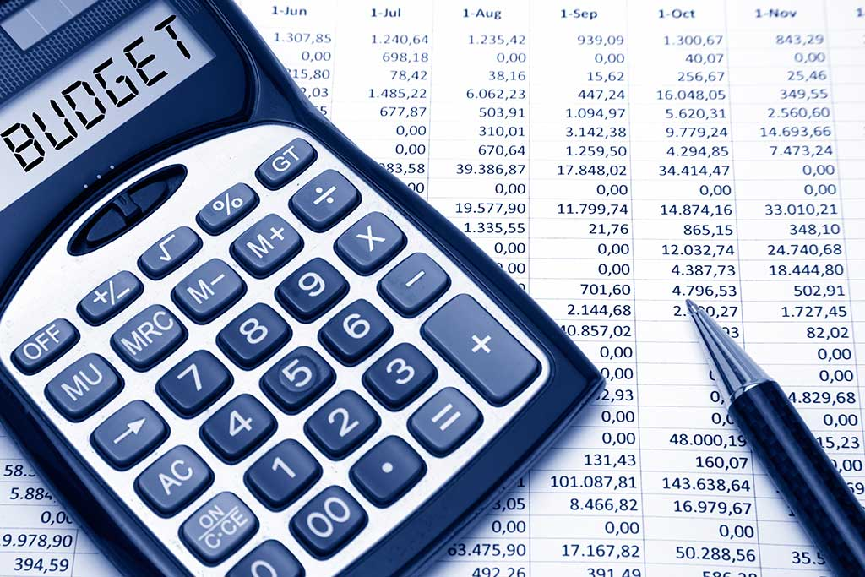
Smart Lock Cost Analysis
Equipment | Cost
Locking Mechanism [2] | $69.00
Image Processing Camera [2] | $24.16
RFID [2] | $19.99
Finger Print Sensor [2] | $50.00
PCB Design [ 5 pieces ] | $35
PCB components [2 times] [BOM] | $50
Prototype [hardware] | $50
LEDS [10] | $2.99
TFT 2.8" Touchscreen [2] | $30
Batteries (9V Alkaline) [3] | $20
Bluetooth card | $5
Camera | ~$200
Total Cost | $356.14
Budget
Notes:
Mark
add bluetooth -
add camera - hvc ~200

Slide 33
Timeline
May - June
November
Planning, Gantt Chart, ERD, divide and quan initiated, documentation, Power Supply
Testing, Presentation preparation, Presenting project
July - August
September - October
Table of Content and documentation completed. Schematics, MCU, Sensors testings
PCB, Hardware testing,
CDR presentation, App, Facial Rec camera
Notes:
Noor

Slide 34
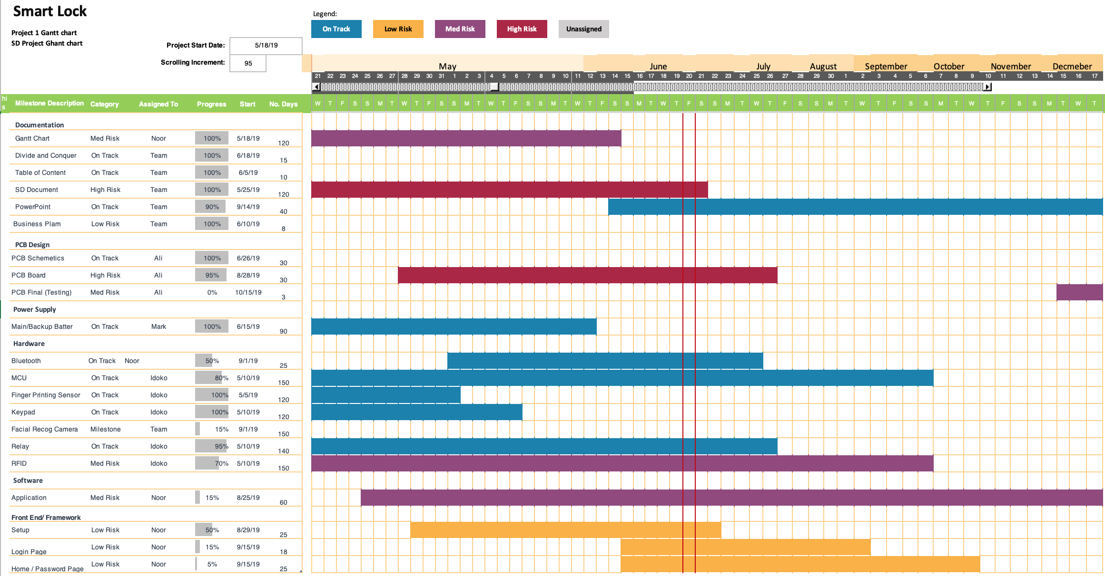
Notes:
Noor

Slide 35
Senior Design 1 Milestone
Description | Week # | Dates
Brainstorming | 1 | May 14 - May 21
Project Selection | 2 | May 21 - May 29
Divide and Conquer 1.0 & 2.0 | 2 | May 21 - May 29
Research and Documentation | 4 | June 7 - July 7
Table of Contents | 6 | 7-Jun
Writing | 6 | June 7 - July 7
Senior Design 1 Draft | 7 | 7-Jul
Research and Design | 7 | 7-Jul
Finalizing the Paper | 8 | 13-Jul
Final Document | 10 | 20-Jul
Milestones
Notes:
Mark
as part of divide and conquer we setup a milestone chart

Slide 36
Milestones
Senior Design 2 Milestone
Description | Week # | Dates
Build Prototype | 5 - 7 | Sep 21 – Oct 1
CDR Presentation | 6 | Sep 26
Testing & Redesign | 7 - 10 | Oct 1 – Oct 22
Finalize Prototype | 10 - 13 | Oct 22 – Nov 12
Final Report | 14 | Nov 19
Final Presentation |  | TBA
Notes:
Mark

Slide 37
Thank You
Notes:
All

Slide 38
QUESTIONS
Notes:
All

